Slide 1
SAP Gateway
Strictly for internal use
One Technology, a World of Experiences

Slide 2
DAY – 2A

Slide 3
SAP Gateway
Day III Agenda
Hands on CRUDQ operations (Code Based Technique)
How to Redefine methods at MPC and DPC level
Function Import
How to display messages in HTTP responses & Header

Slide 4
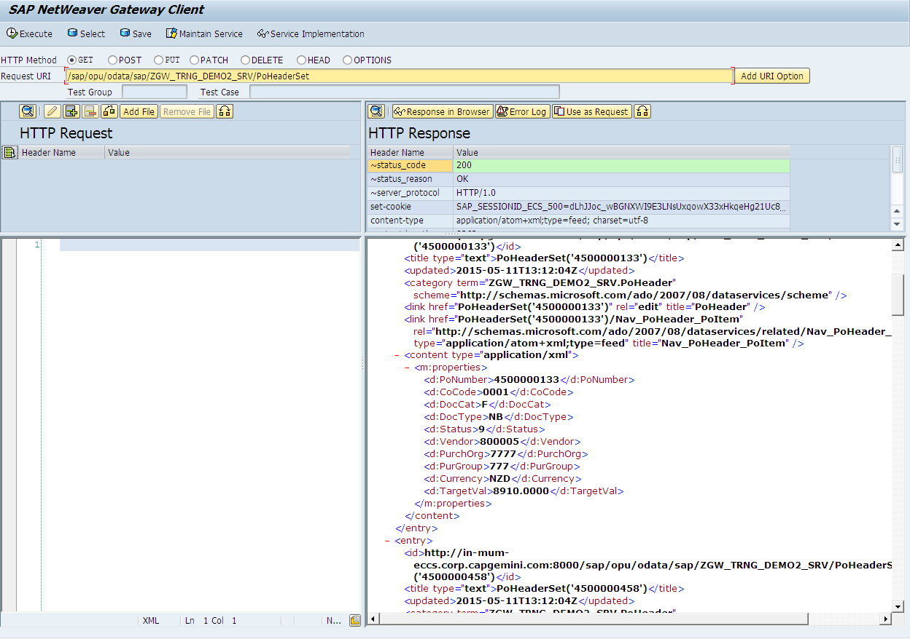
Read Operation
GWI-EO:GWI-EO-03
Case 1: Fetch the list of purchase orders
Method to be implemented : PoHeaderSet_Get_EntitySet
Service URI: /sap/opu/odata/sap/ZGW_TRNG_DEMO2_SRV/PoHeaderSet

Slide 5
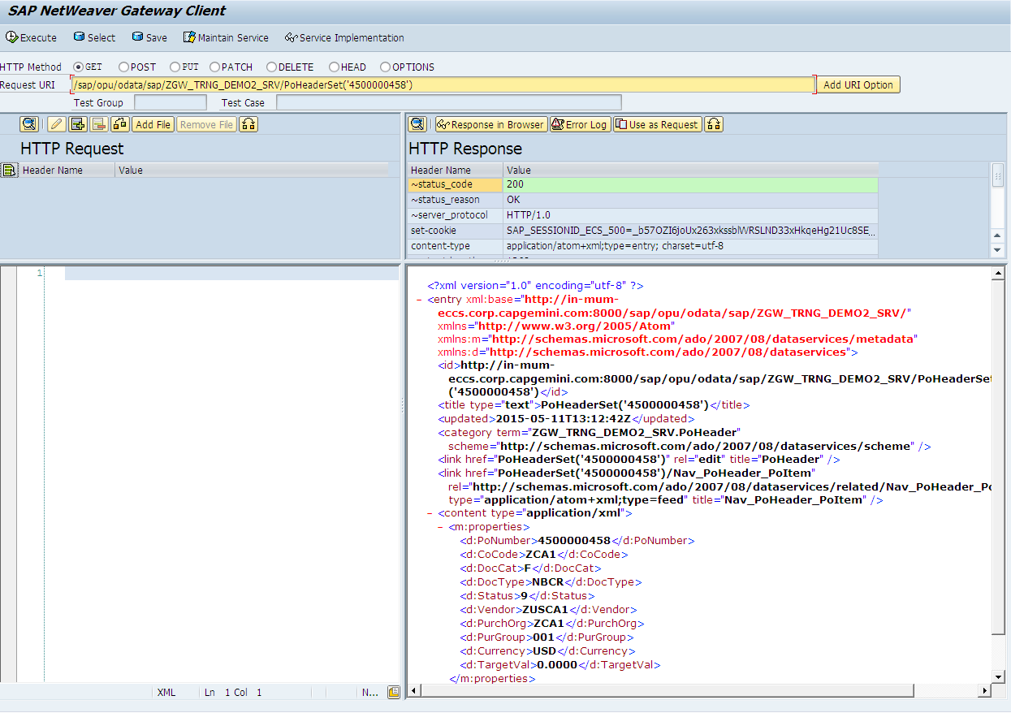
Read Operation (Cont..)
GWI-EO:GWI-EO-03
Case 2: Fetch the details of a specific purchase order
Method to be implemented : PoHeaderSet_Get_EntitySet
Service URI: /sap/opu/odata/sap/ZGW_TRNG_DEMO2_SRV/PoHeaderSet('4500000458')

Slide 6
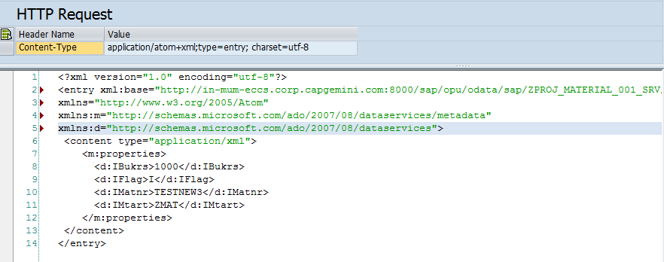
Create
Create Operation:
We can send the request payloads in both XML and JSON formats.
Sample Request URI and Payload
URI: /sap/opu/odata/sap/ZGW_TRAINING_NITIN1_SRV/MatSet
HTTP Method: POST

Slide 7
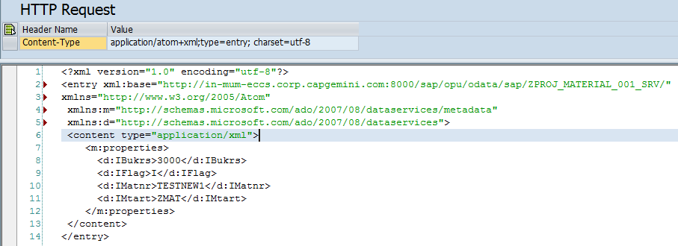
Update
Update Operation:
We can send the request payloads in both XML and JSON formats. Sample Request URI and Payload
URI: /sap/opu/odata/sap/ZGW_TRAINING_NITIN1_SRV/MatSet(IFlag='U',IMatnr='TESTNEW1')
HTTP Method : PUT

Slide 8
Function Import
Function Import
OData supports further service operations (function imports) that can be invoked by the HTTP methods GET or POST for anything that cannot be mapped to the standard CRUD operations. You can implement such additional service operations in the Service Builder by creating function imports within your data model.
HTTP Method: GET/POST
Note: While it is simple to create new function imports to invoke custom operations, if the operation you want to use can be invoked using a standard CRUD operation, you should not create a function import.

Slide 9
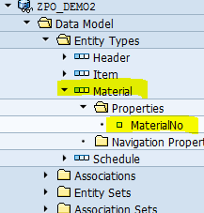
Function Import
GWI-EO:GWI-EO-02
Function Import example:
https://help.sap.com/saphelp_nw74/helpdata/en/c5/dc22512c312314e10000000a44176d/content.htm
We will consider material validation example here.
Create a project in SEGW
Create an entity type name material with the following properties

Slide 10

Function Import
GWI-EO:GWI-EO-02
Function Import example:
We only need one property i.e. material number here as we will send back only material number if it is valid.
Right click on function imports->Create -> Enter the following properties
Create an import parameter for the function import:

Slide 11
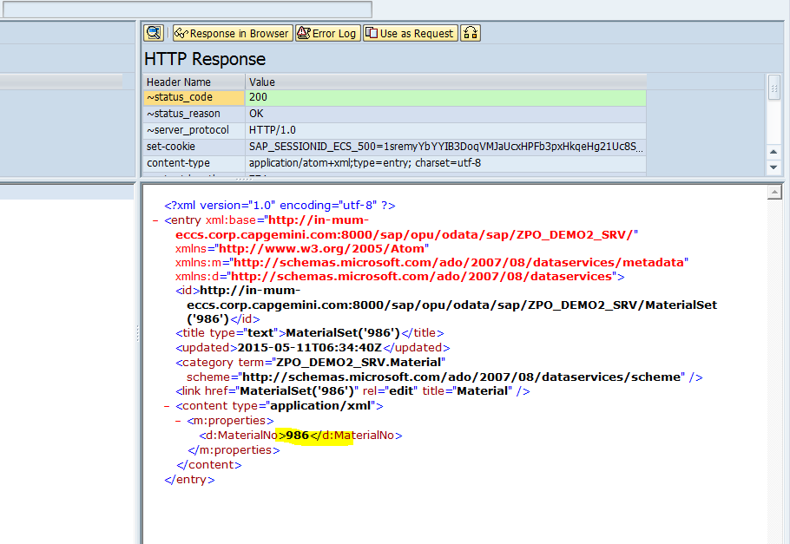
Function Import
GWI-EO:GWI-EO-02
Test from GW client with the URI:
URI:
/sap/opu/odata/sap/ZPO_DEMO2_SRV/MaterialCheck?Material='986'

